Slide 1

FREE
EBOOK!
How To Create Free Websites
Mthokozisi Dlangalala.
Find Links to helpful Sites.
Products to help you in Website Creation!

Slide 2
How To Create Free Websites and rank number one
SEO OPTIMIZATION: If you want your Websites to rank number one on Google. Click here!
Your guide to creating simple beautiful website and hosting for absolutely free. Yes Free website and Free hosting!
Learn how to rank your site number one.
FREE EBOOK!

Slide 3
Content
17. Rank Number One
14. Fun Creating Your Site
4. What are servers?
6. Cloud Servers
7. Types of Websites
8. Difference between static and dynamic websites
9. Recommended type of Website
10. Coding Languages
15. Recommended Free Website Builders
11. CSS Explained
12. Code(optional)
16. Recommended Servers
5. Types of servers.

Slide 4
Content
17. Rank Number One
9. Recommended types of Websites
9. Recommended types of Websites
10. Coding Languages
15. Recommended Free Website Builders
11. CSS Explained
12. Code(optional)
16. Recommended Servers
5. Types of servers.
14. Fun Creating Your Site
10. Coding Languages
4. What are servers?
15. Recommended Free Website Builders
6. Cloud Servers
11. CSS Explained
7. Types of Websites
12. Code(optional)
8. Difference between
static and dynamic websites
16. Recommended Servers
5. Types of servers.

Slide 5

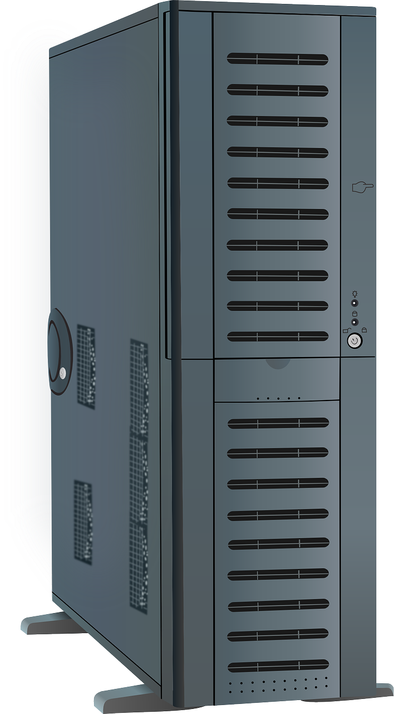
What are Servers?
In order to start our journey we must learn a little bit
about the background of website creation. Just simple stuff like
The server.
noun
plural noun: servers
1.
a person or thing that serves.
2.
a computer or computer program which manages access to a centralized resource or service in a network.
"the software runs on a variety of Unix servers“
A server is a computer device that provides a service to another computer program and its user, also known as the client. Basically a server is where our website lives , the storage device for a website. Server allows our website functionality.
Back to Contents page

Slide 6
Types of Servers
There are two types of servers that we can use. These are the following.
Type A
A Physically run server, is referred to as Server Based. You have to be there physically in order to access some functions.
Server based computing refers to the applications running on the server. A server refers to a dedicated computer tasked with managing network resources. In simple terms, a server is an instance of a computer program that accepts and responds to the requests made by other programs in the network, also known as clients.
Back to Contents page

Slide 7


Cloud Servers
Type B
In some instances in order to have a free website we have to access a cloud based server.
A Cloud based server can be run remotely.
Cloud refers to a pool of shared computing resources available to the users on demand through web-based tools via the internet. The whole idea of cloud computing is to shift everything to the cloud so that user can access the data remotely without being physically present at a specific place. This makes data processing and storage convenient and efficient than ever. Many businesses and organizations have started adopting this paradigm as a potential game changer to their businesses.
Back to Contents page

Slide 8

Types of Websites
Static website A static website is a kind of website you can build. Static websites are coded in HTML and CSS only, with no scripting. The only form of interactivity on a static website is hyperlinks. They are easier to code and assemble. We won’t be needing to code anything as there are free website builder programs and apps that we will explorer for our free website. Because of their Simplicity they can be run in a Cloud based Server
Dynamic Website
A dynamic website is a site that contains dynamic pages such as templates, contents, scripts etc. In a nutshell, the dynamic website displays various content types every time it is browsed. The web page can be changed with the reader that opens the page, character of consumer interplay, or day time.
Back to Contents page

Slide 9
Difference Between Static and Dynamic
There are two types of websites we can utilize, Static and Dynamic. Here are the possibilities of each.
Possibilities | Static | Dynamic
Simple images | √ | √
links | √ | √
Blogging | √ | √
Storing Data | x | √
Online Store | √ | √
Back to Contents page

Slide 10
Recommended type of Website
A static site is recommended if you have a simple website e.g. a site that displays static images or information. A static website is like a business card or brochure online.
It’s great for displaying information that does not require constant updates.
Dynamic websites are for functionality and hence usually have coding involved in their creation. Dynamic websites can be easily updated and upgraded. We need a dynamic website if we plan on registering clients to database on our website.
Back to Contents page

Slide 11

Coding Languages
Code (optional)
Websites are created using code or scripting. The code scripting is divided into many different groups called languages. The main coding language for websites is HTML. Here is a list of coding languages and a link to w3school that teaches the fundamentals of coding. https://www.w3schools.com/
List of Coding Languages:
HTML
JAVASCRIPT
PHP
PYTHON
JAVA
MICROSOFT.NET
ANGULAR
Back to Contents page

Slide 12
CSS(Cascading Styles Sheet) Explained
Along with the HTML is a language called CSS used to structure and style websites. CSS makes it easy to style multiple pages at once with the same style instead of editing the same theme one page at a time, wasting hours of time.
CSS help with things like header and footer since they usually generic, through whole website. This is the language used by the website builders to make our website creation experience simple and effortless. Here is a simple video to illustrate CSS use with html to create a website.
Vid embeded
Back to Contents page

Slide 13
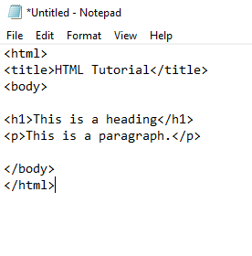
CODE
Code can be written even on your computers notepad. All you have to do is type the html code then run or open with a browser like Windows Explorer or Chrome.
Here is an example of code in html that you can type on your notepad and run with your web browser to see for yourself.
Back to Contents page

Slide 14

Fun! Creating your site!
Now that we have covered the background of website creation let us get on with the website creation!
It’s always best to plan the structure of your site. So first is your home page, then product page, then product or services description page aka about page, then finally a contact page or even a Sign up button if you have more experience coding.
The very first thing you need to have is a index page. You will see this word a lot in the website creation world. Index page is the first page usually created for a website. It is referred to by most people as the HOME page. No worries because our free website builders cover this.
Back to Contents page

Slide 15

Fun! Creating your site!
These days you need not worry about anything else besides the structure, look and feel of website. The programs and apps I will show you sort all of this out. And for most, you just have to drag and drop your content, no coding at all.
Most of these services are for static sites as they are more simple as explained here in the “TYPES OF WEBSITES” chapter here in this book.
If you are a novice developer or planning to create more dynamic websites, then you will be happy to know that there are free server services that allow you to upload your site with your own code. The list is right here in this book.
Back to Contents page

Slide 16

Recommended Free Website Builders
Here are website builders that websites for FREE as promised.
Note: although these are for free, most of them include an option to upgrade to paid for more features.
Webnode Wix Weebly Ucraft Mobirise
Back to Contents page

Slide 17
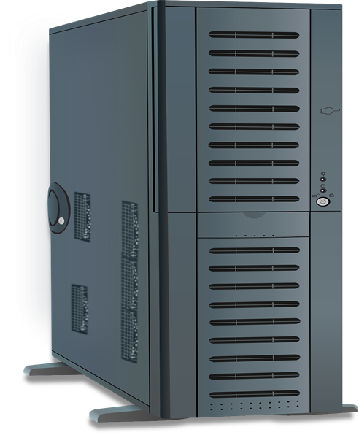
Recommend Servers
Remember when we skimmed through servers? Well here are some server services offered for Free. Here coders can enjoy the flexibility of creating there projects for FREE HOSTING
AMAZON WEB BASED SERVICES
RED HAT
HEROKU
GOOGLE COMPUTE ENGINE
MICROSFT AZURE
Back to Contents page

Slide 18
Rank Number One
In order to rank number one your website has be recognised easily by Google through how it is structure. This is where things like keywords and meta data come in. The way you structure the website and how informative or valuable your content is, is very important to Google. So here is a wonderful product to help us in that regard. https://jvz6.com/c/1530179/275301
Back to Contents page

